Slide 1
FreeSurfer for structural MRI
MRI Users Meeting
7 Nov 2017
Jenny Rieck

Slide 2
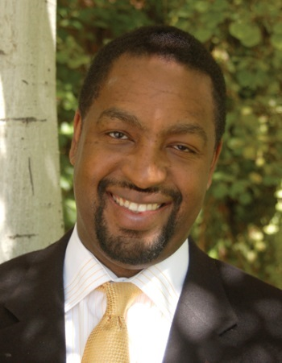
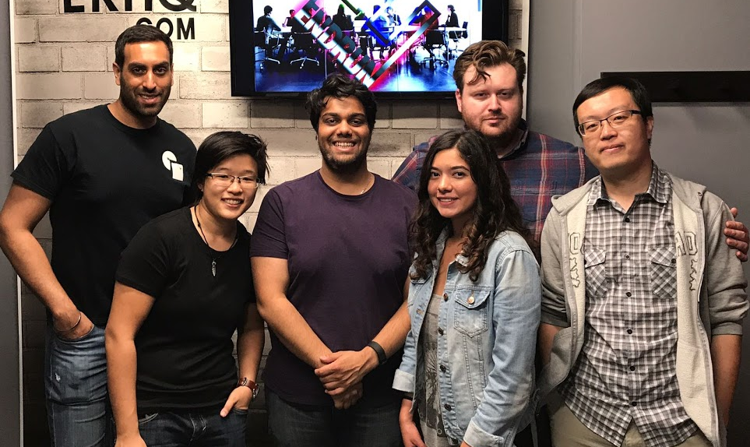
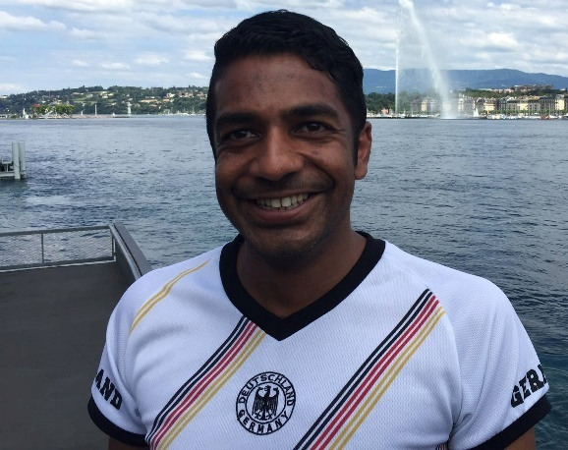
Acknowledgments
Richard King (U Utah)
Wig Lab (UT Dallas)
Micaela Chan, Neil Savalia & Philip Agres
Gérard Bischof
(U Hospital Cologne)

Slide 3
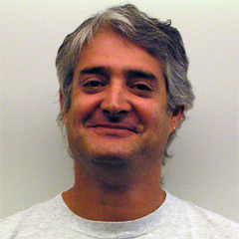

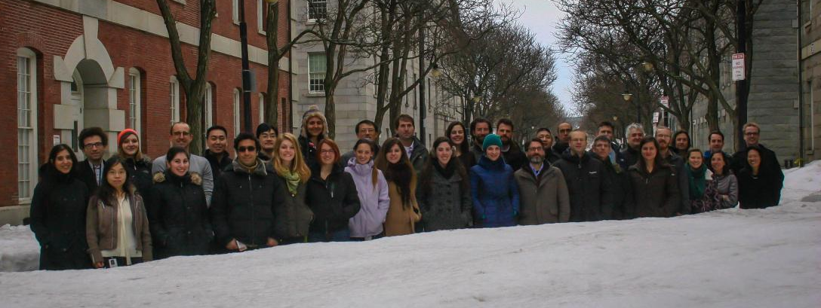
What is FreeSurfer?
Freely available software suite developed by Bruce Fischl and Doug Greve at MGH
Set of automated tools for reconstruction of the brain’s cortical surface from structural* MRI data
Freesurfer team @ MGH:
Bruce Fischl
Doug Greve
Laboratory for Computational Neuroimaging
Martinos Center for Biomedical Imaging

Slide 4
What can FreeSurfer do for you?
Structural MRI
Skull stripping, bias field correction, gray-white matter segmentation
Reconstruction of cortical surface models
Labeling of regions of cortical surface and subcortical brain structures
Computation of cortical thickness, surface area and volume measures & subcortical volume measures
Statistical analysis of group morphometry differences (Qdec)
Diffusion MRI
Reconstruction of major white matter pathways via probabilistic tractography (TRACULA)
Functional MRI
Statistical analysis of functional data on the cortical surface (FS-FAST)
Multimodal registration

Slide 5
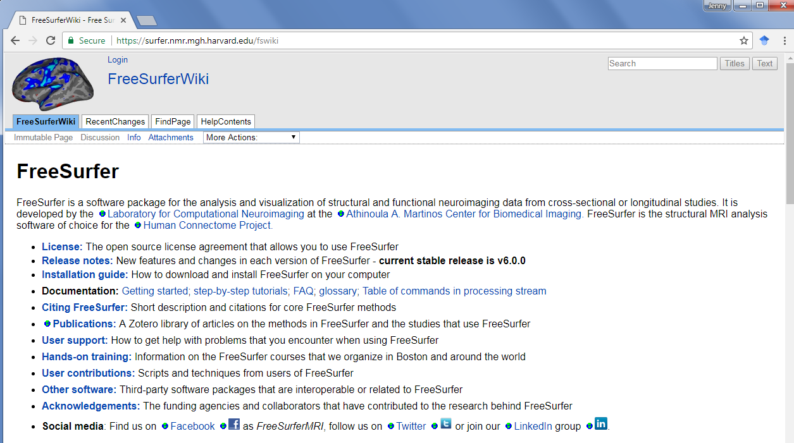
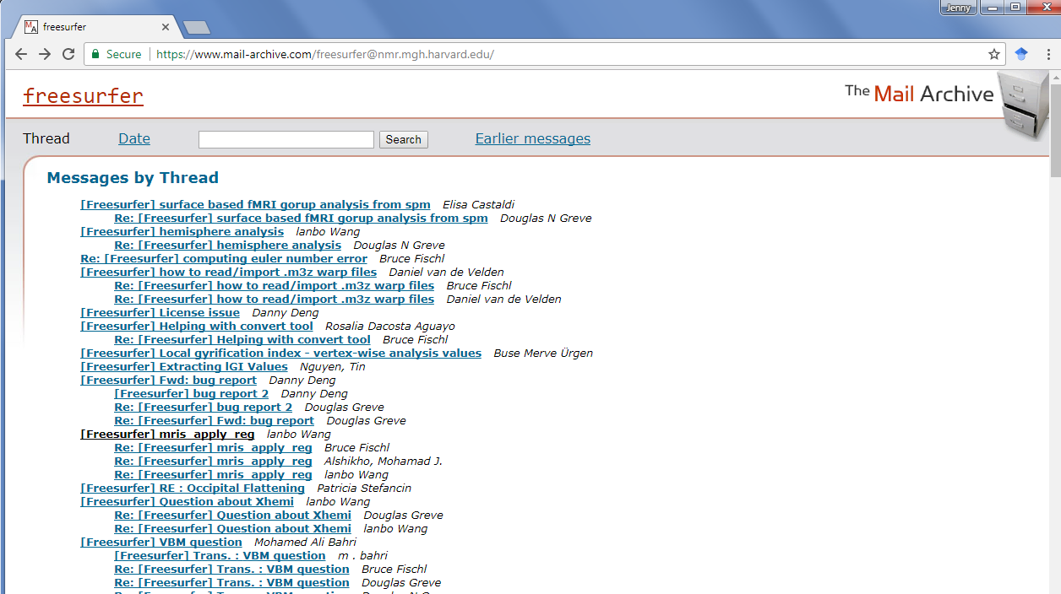
FreeSurfer Resources
Wiki!
Mailing List!

Slide 6
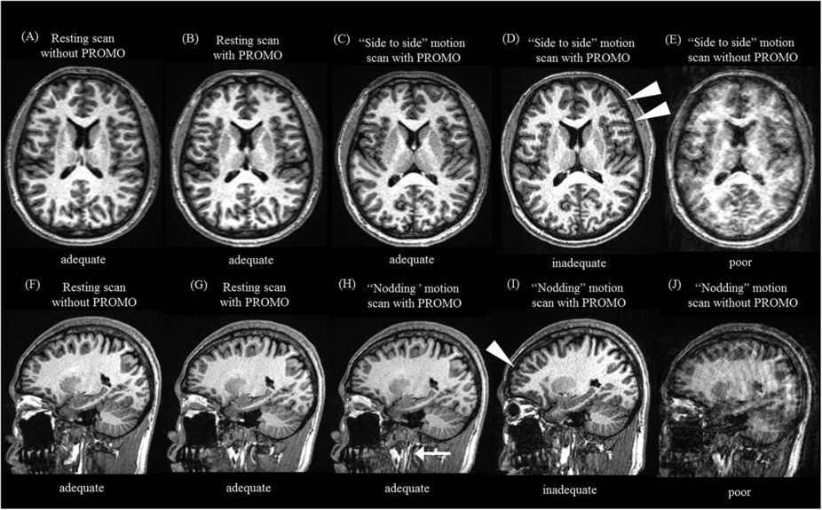


What do you need to run Freesurfer?
Data requirements
Good quality T1 weighted MRI data (e.g. Siemens MPRAGE or GE SPGR sequence)
At least 1mm³ voxel size recommended
Good gray/white matter contrast
Minimal movement artifacts

Slide 7
What do you need to run Freesurfer?
System Requirements
Mac OS X
PC running Linux (or VirtualBox through Windows)
At the Rotman: access to VN1 or the Grid servers
Note. FreeSurfer consumes a lot of processor time, memory resources and disk space. It is recommended to run FreeSurfer on the most powerful machine possible!

Slide 8
FreeSurfer Inputs/Outputs
Inputs
Freesurfer can read/write: Nifti, Analyze, MINC
Freesurfer can read: DICOM, Siemens, IMA, AFNI
Outputs
.mgz = compressed MGH file
can store data in 4D (cols, rows, slices, frames)
/surf/ e.g., lh.pial lh.white
/label/ = assign each vertex a label/annotation

Slide 9
recon-all is the backbone of FreeSurfer
$: export SUBJECTS_DIR=/data/grady_lab/ jrieck/fmri147/freesurfer
$: recon-all -i myMPRAGE.nii -s bert -sd /subjdir/ -all
Note. Commands may differ based on bash vs tcsh

Slide 10
recon-all Processing Flow
MPRAGE
T1 - weighted Image
autorecon1
Alignment
Check
autorecon2
Control Points
Check
White Matter Edits
Check
Pial Surface
Check
autorecon3
Pre-Editing
Editing
https://surfer.nmr.mgh.harvard.edu/fswiki/recon-all

Slide 11
Recon-all -autorecon1
Motion correction and conform
Non-Uniform Intensity normalization
Talairach transform computation
Intensity Normalization 1
Skull Strip
$: recon-all –autorecon1 –s bert

Slide 12
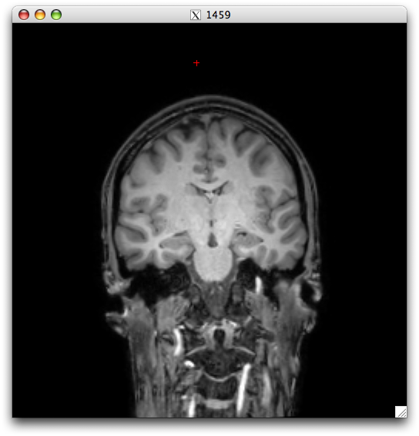
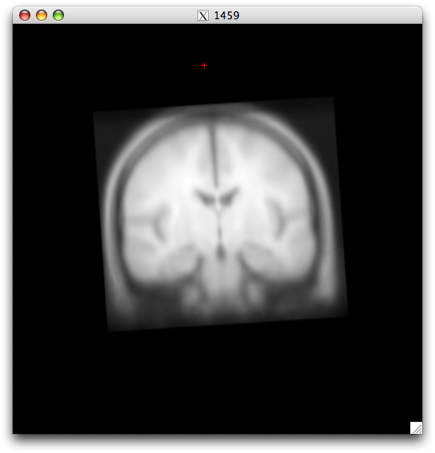
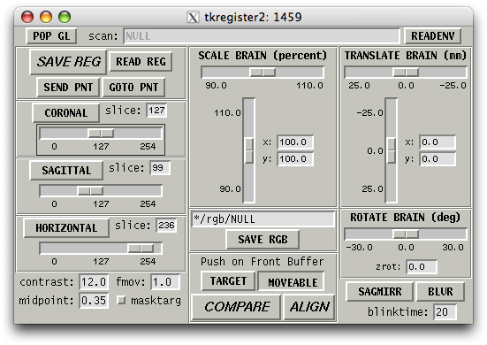
Alignment Check – tkregister2
$: tkregister2 --mgz --s bert --fstal
https://surfer.nmr.mgh.harvard.edu/fswiki/FsTutorial/ManualRegistration
Notes:
https://surfer.nmr.mgh.harvard.edu/fswiki/FsTutorial/ManualRegistration

Slide 13
recon-all -autorecon2
Linear volumetric registration
CA Intensity Normalization
CA Non-linear Volumetric Registration
Remove Neck
LTA with skull
CA Label (Volumetric Labeling, ie aseg) and statistics
Intensity Normalization 2 (start here for cp)
White matter segmentation
Edit WM with aseg
Fill (start here for wm edits)
Tessellation
Smooth1
Inflate1
Qsphere
Automatic Topology Fixer
Final Surfs (start here for brain edits to pial surf)
Smooth2
Inflate2
$: recon-all -autorecon2 –s bert

Slide 14
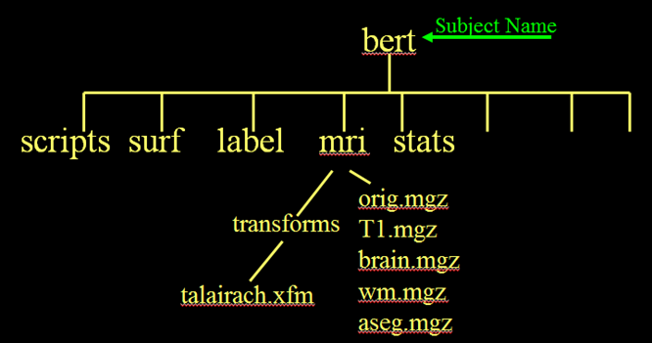
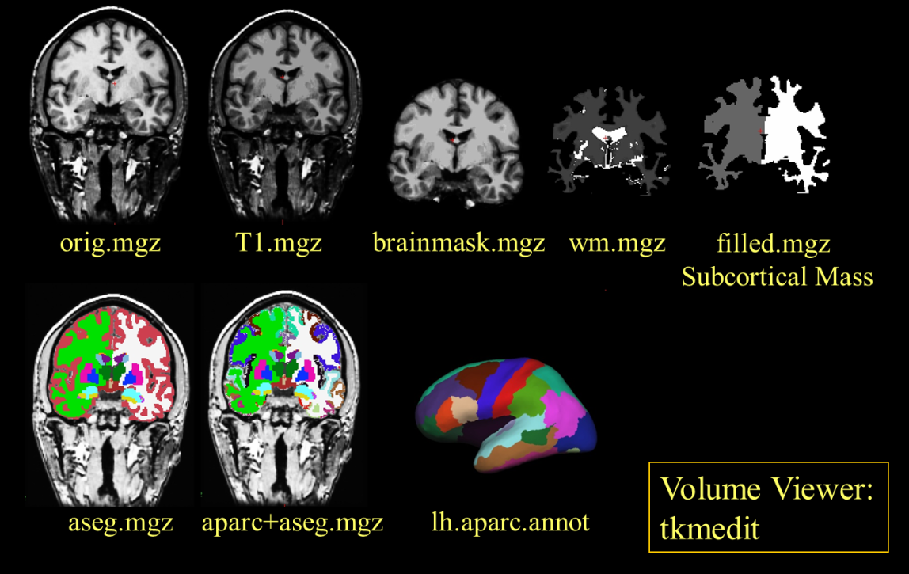
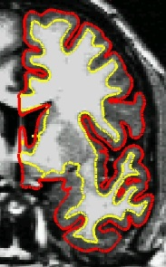
Data structure and output overview
rh.white
rh.pial

Slide 15
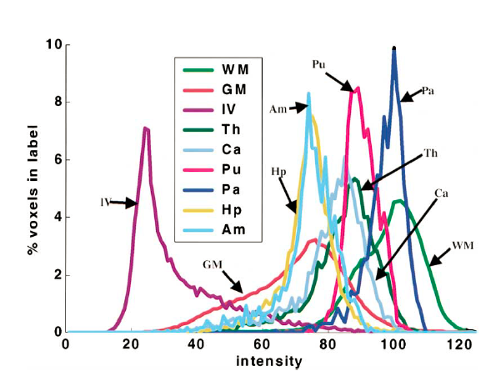
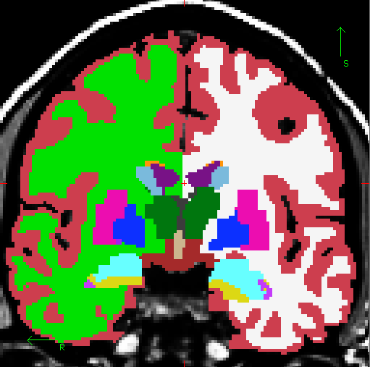
Volumetric Segmentation (aseg)
37 segmentation labels
39 Subjects (14M, 25F)
10 Young
10 Middle-Aged
8 Old Healthy
11 Alzheimer’s
Siemens 1.5T Vision (Wash U)
Lateral Ventricle
Cortex
Thalamus
White Matter
Putamen
Caudate
Amygdala
Pallidum
Hippocampus
Whole Brain Segmentation: Automated Labeling of Neuroanatomical Structures in the Human Brain, Fischl, B., et al., (2002). Neuron, 33:341-355.

Slide 16
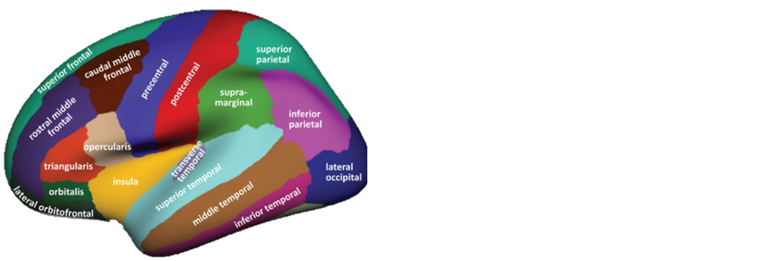
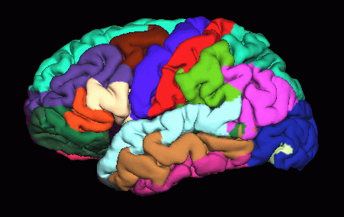
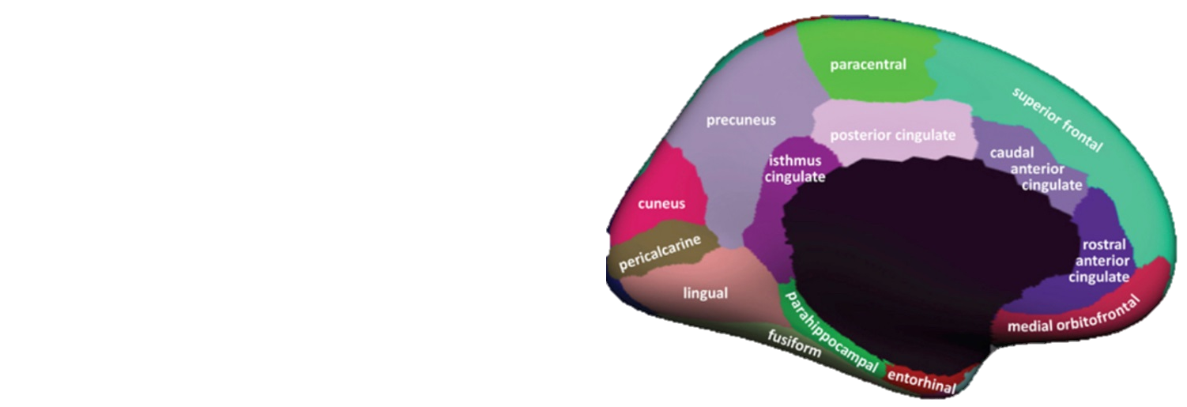
Automatic Surface Parcellation (aparc): Desikan-Killiany Atlas
35 ROIs (left & right hemisphere) based on gyral morphometry
40 Subjects
14 Male, 26 Female
Ages 18-87
30 Nondemented
10 Demented
Siemens 1.5T Vision (Wash U)
An automated labeling system for subdividing the human cerebral cortex on MRI scans into gyral based regions of interest, Desikan RS, et al., (2006). NeuroImage 31(3):968-80.

Slide 17
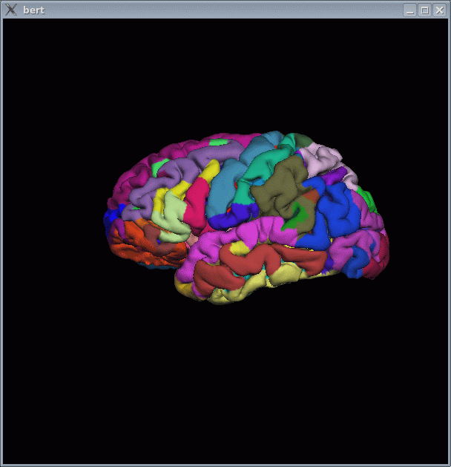
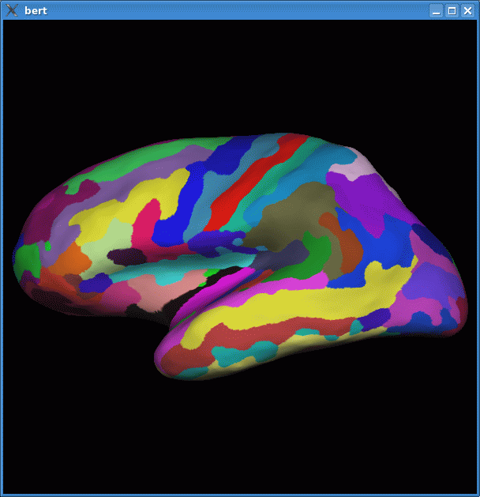
Automatic Surface Parcellation (aparc): Destrieux Atlas
85 ROIs (left & right hemisphere) based on sulcal & gyral morphometry
12 subjects
Precentral Gyrus
Postcentral Gyrus
Central Sulcus
Precentral Gyrus
Postcentral Gyrus
Automatically Parcellating the Human Cerebral Cortex, Fischl B, et al., (2004). Cerebral Cortex, 14:11-22.

Slide 18
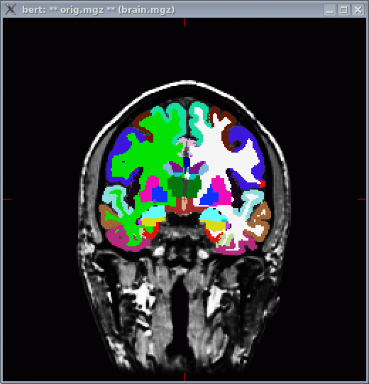
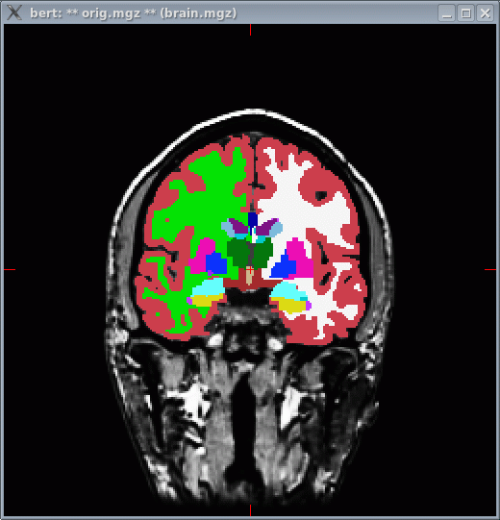
Merged Cortical + Subcortical
aparc
aparc+aseg
aseg

Slide 19
recon-all -autorecon3
Spherical Mapping
Spherical Registration
Spherical Registration, contralateral hemi
Map avg curvature to subject
Cortical Parcellation – Desikan Killiany & Destrieux labeling
Cortical Parcellation Statistics
Cortical Ribbon Mask
Cortical Parcellation mapping to aseg

Slide 20
FreeSurfer Failures
Hard Failures
error in running recon-all
Computer issue
Data quality issue
Check the subjects recon-all.log & recon-all.error files in /scripts/
$: tail -25 recon-all.log
$: cat reconall.log | grep -B 10 -A 10 “exited with ERRORS”

Slide 21

FreeSurfer Failures
Soft Failures
recon-all finishes processing your data but requires modifications or manual interventions
Poor anatomical data input
Abnormal bran structure
Detected by visual inspection of the surface outputs

Slide 22
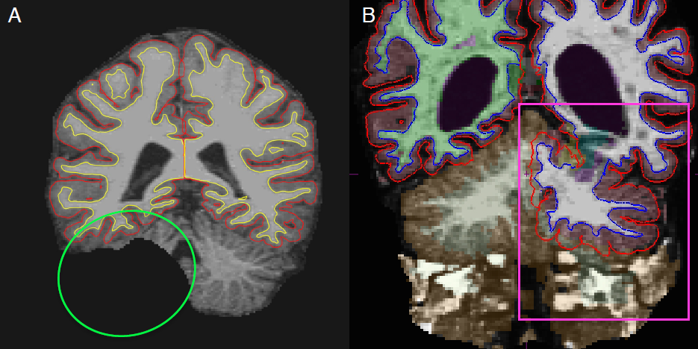
Skull stripping issue
Failure to properly mask out non-brain
May be overly aggressive or not aggressive enough
https://surfer.nmr.mgh.harvard.edu/fswiki/FsTutorial/SkullStripFix_freeview

Slide 23
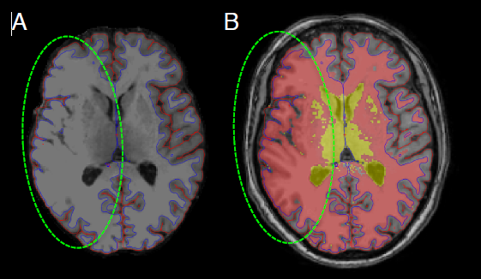
Intensity normalization issue
Intensity normalization helps distinguish between gm and wm
dependent on an input T1 image that contains sufficient grey/white contrast.
Inconsistent/erratic intensity normalization of T1 can lead to faulty tissue-type classifications, and substantial inaccuracies in segmentation and anatomical surface generation

Slide 24
Segmentation Issue
Faulty output label files, inaccurate extraction of cerebral gm, flawed surface map

Slide 25
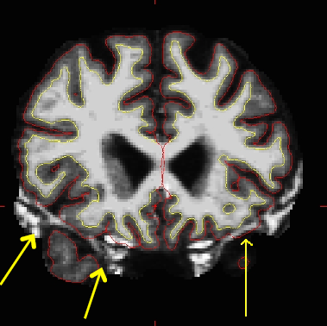
Pial Surface Issue
Misplaced pial surface can lead to
inaccurate surface mapping,
poor quality thickness and volumetric segmentation statistics

Slide 26
Manual Editing
Control Points – correct excluded cortex (generally a portion of a gyrus); correct wm labeled as gm
White Matter Edits – correct ventricle/wm labeled as cortex
Pial Edits – correct non-brain (dura, cerebellum) labeled as cortex

Slide 27
FreeSurfer Brian Viewers/Editors
Freeview
TKMedit

Slide 28
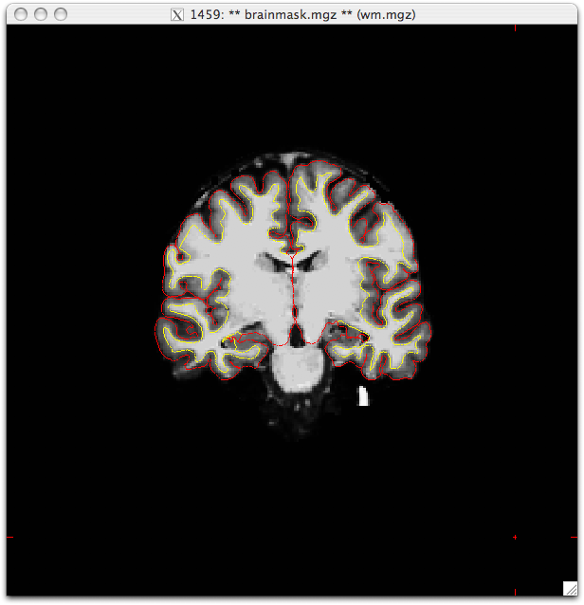
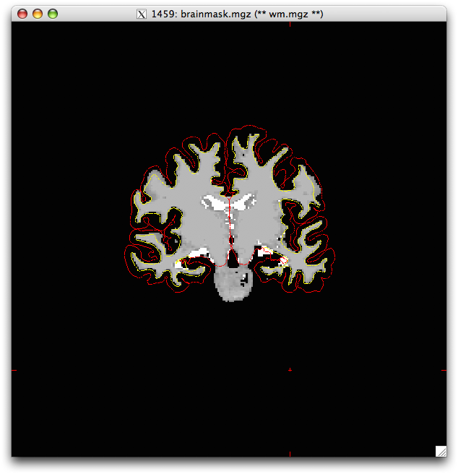
Brain Mask
pial surface
gm/wm surface
Main volume (brainmask.mgz)
Aux volume (wm.mgz)

Slide 29
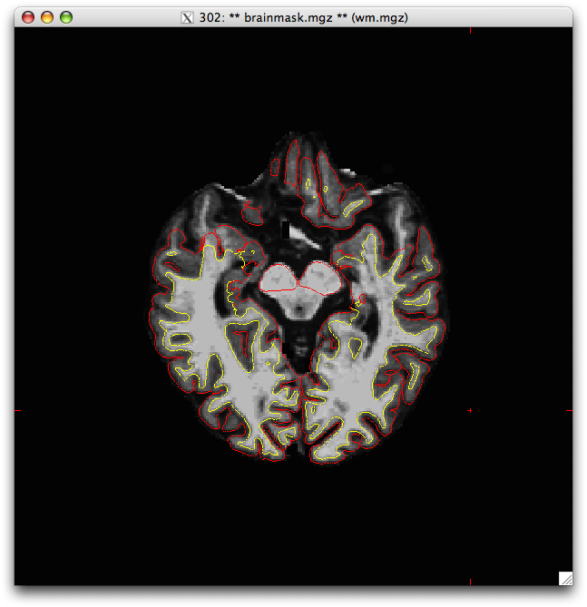
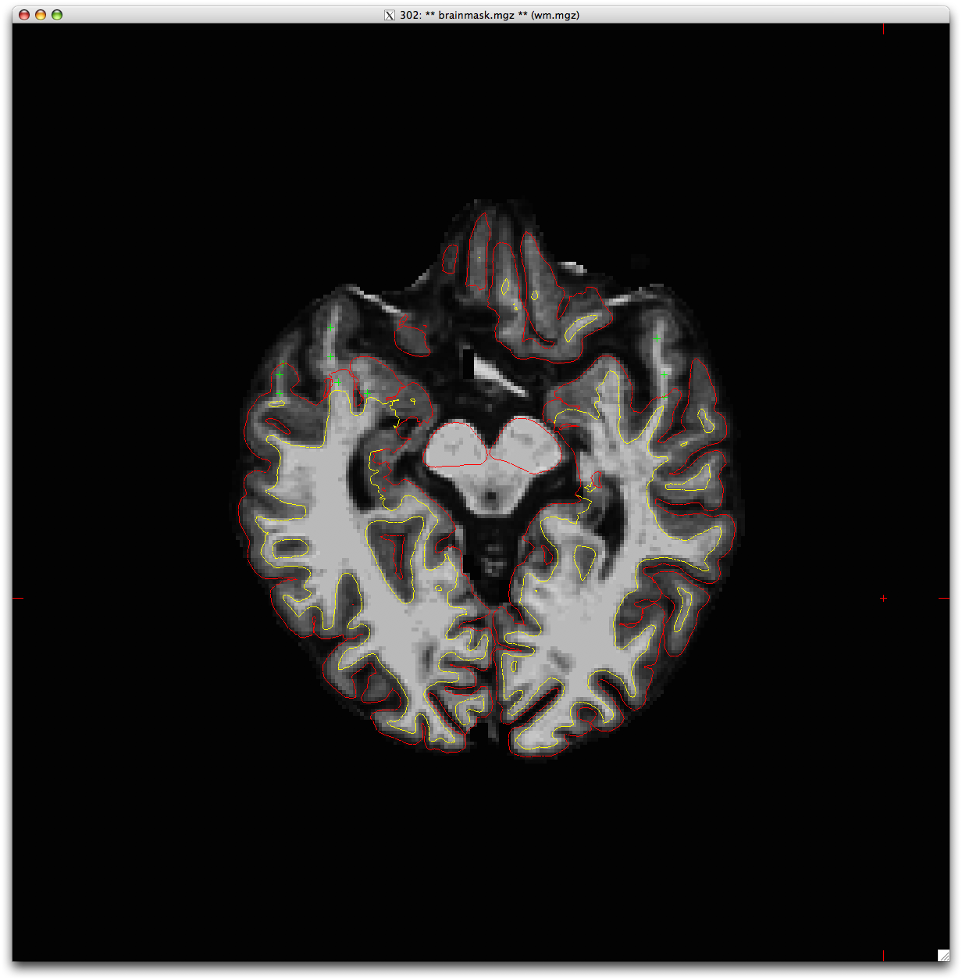
Control Points (CP)
CPs should be used when gray matter is not captured within the gm boundary (red line)
Control points increase the intensity values for this location (and surrounding slices).
This will push both the wm (yellow) and pial (red) boundaries out to include the missing cortex

Slide 30
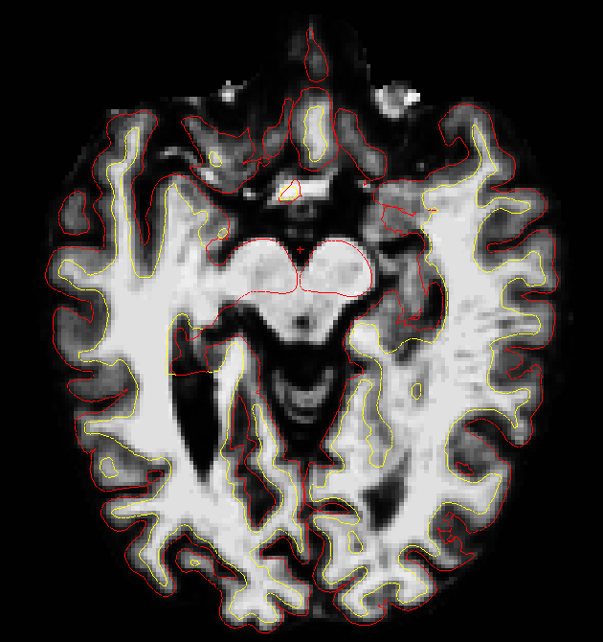
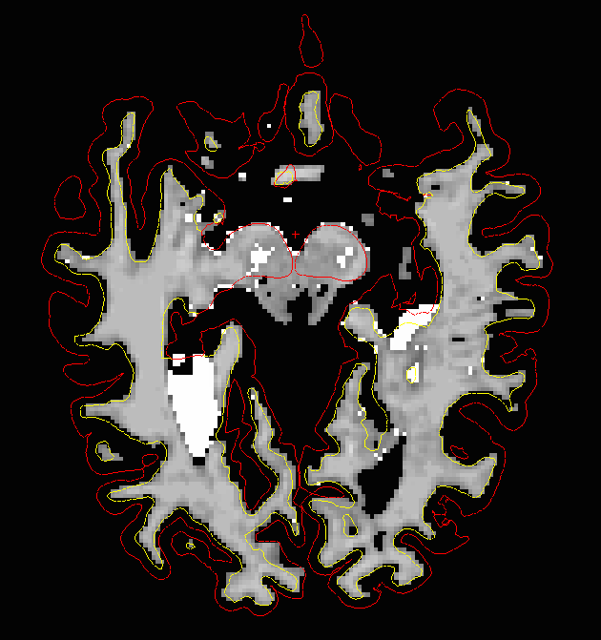
White Matter Edits (WM)
White matter edits should be done when gm/wm boundaries exist within wm or ventricles
As good practice you should fill all ventricles.
WM fills will push the gm/wm & pial boundary past the point you fill in

Slide 31
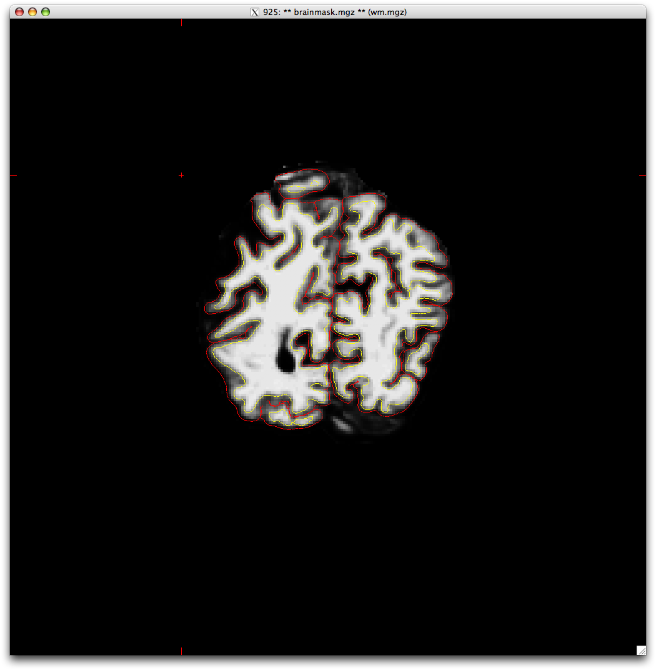

Pial Editing
Pial editing should be done when non-brain tissue is included in the pial boundary (red)
This is frequently an issue near the cerebellum, with blood vessels near ant temporal, and dorsal regions of the midline

Slide 32



Slide 33
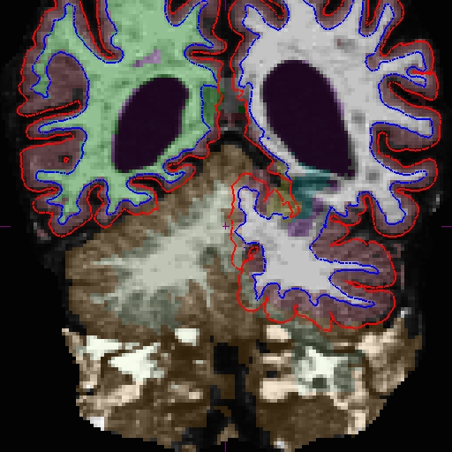
What’s wrong with this parcellation?

Slide 34
Cerebellum included in the cortical parcellation!

Slide 35
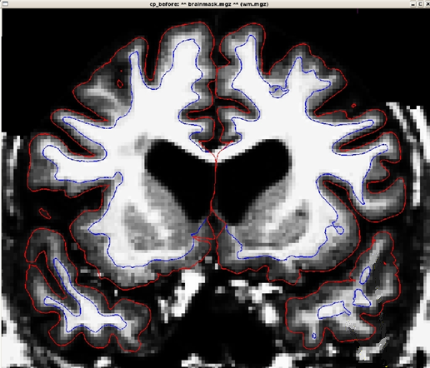
What kind of edit would you make?

Slide 36
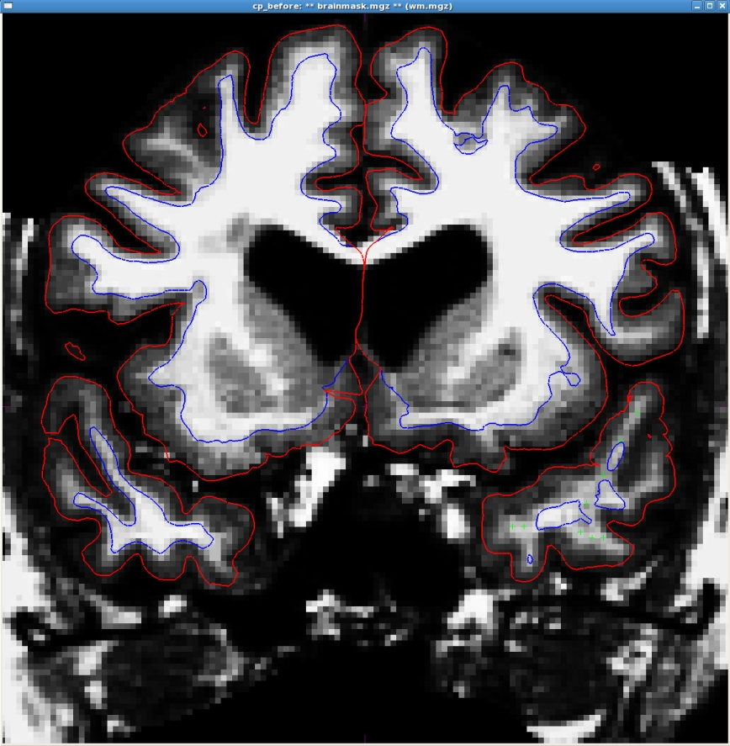
Answer: Add control points to R Temporal Lobe
+
+
+
+
+
+
+
+

Slide 37
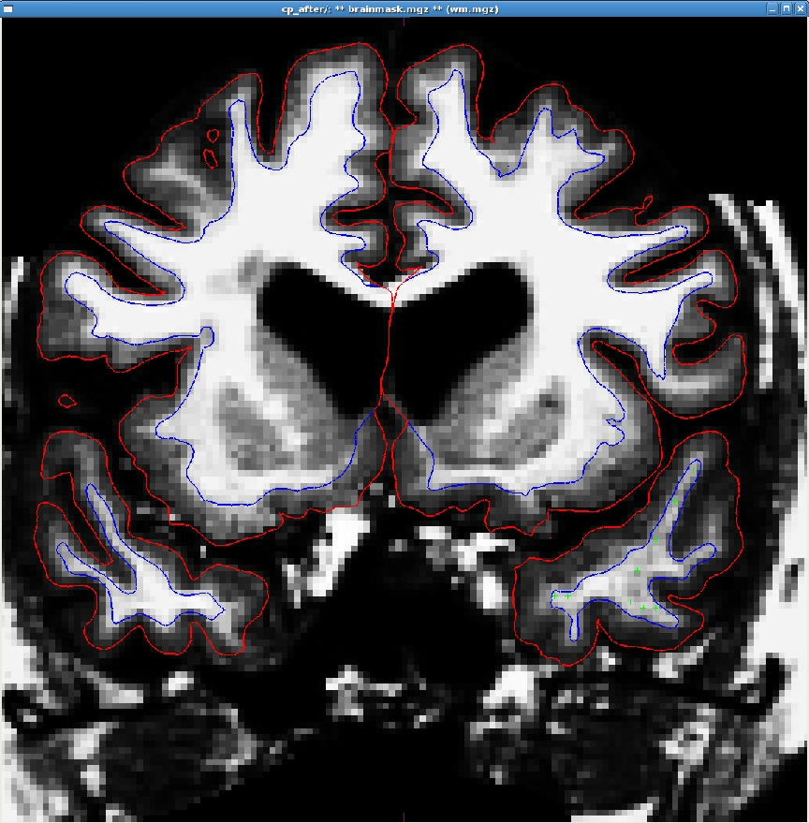
Ta da, it’s fixed!
+
+
+
+
+
+
+
+

Slide 38
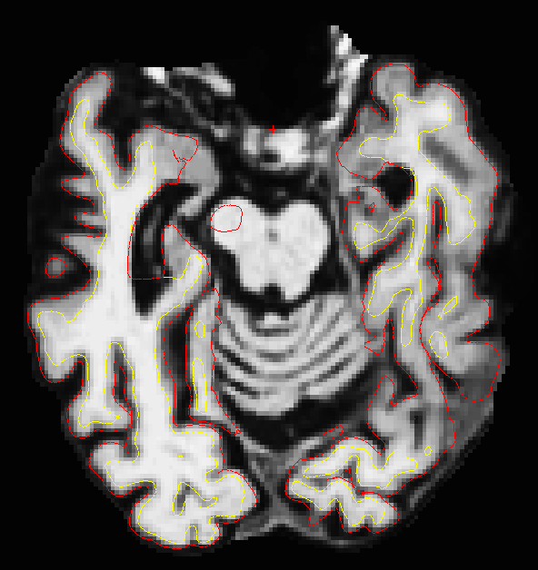
What kind of edit would you make?

Slide 39
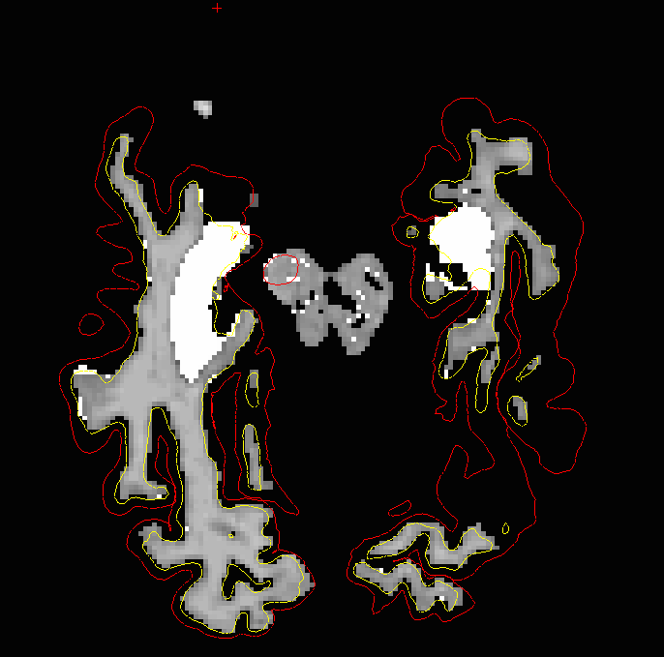
Answer: Fill ventricle space (wm)

Slide 40
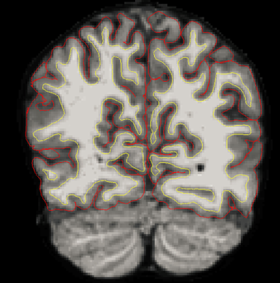
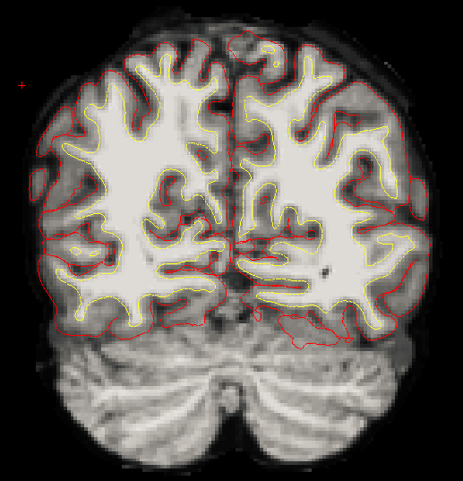
What kind of edit would you make?

Slide 41
Pial edit of sagittal sinus & cerebellum

Slide 42
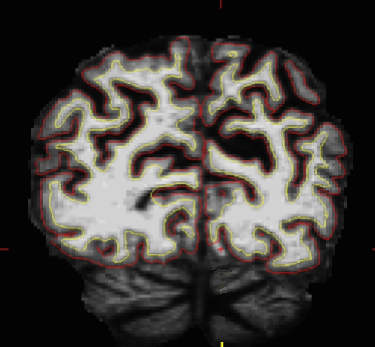
What kind of edit would you make?

Slide 43
Answer: Add control point
+

Slide 44
recon-all Processing Flow
MPRAGE
T1 - weighted Image
autorecon1
Alignment
Check
autorecon2
Control Points
Check
White Matter Edits
Check
Pial Surface
Check
autorecon3
Pre-Editing
Editing
$: recon-all -autorecon2-cp –s bert
$: recon-all -autorecon2-wm –s bert
$: recon-all -autorecon-pial –s bert

Slide 45
recon-all -autorecon3
Spherical Mapping
Spherical Registration
Spherical Registration, contralateral hemi
Map avg curvature to subject
Cortical Parcellation – Desikan Killiany & Destrieux labeling
Cortical Parcellation Statistics
Cortical Ribbon Mask
Cortical Parcellation mapping to aseg

Slide 46
aseg.stats for subcortical volumes
Index SegId NVoxels Volume_mm3 StructName Mean StdDev Min Max Range
1 4 5855 5855.0 Left-Lateral-Ventricle 37.7920 10.9705 20.0000 88.0000 68.0000
2 5 245 245.0 Left-Inf-Lat-Vent 56.4091 9.5906 26.0000 79.0000 53.0000
3 7 16357 16357.0 Left-Cerebellum-White-Matter 91.2850 4.8989 49.0000 106.0000 57.0000
4 8 60367 60367.0 Left-Cerebellum-Cortex 76.3620 9.5724 26.0000 135.0000 109.0000
5 10 7460 7460.0 Left-Thalamus-Proper 91.3778 7.4668 43.0000 108.0000 65.0000
6 11 3133 3133.0 Left-Caudate 78.5801 8.2886 42.0000 107.0000 65.0000
7 12 5521 5521.0 Left-Putamen 86.9680 5.5752 66.0000 106.0000 40.0000
8 13 1816 1816.0 Left-Pallidum 97.7162 3.4302 79.0000 106.0000 27.0000
9 14 852 852.0 3rd-Ventricle 41.9007 11.8230 22.0000 69.0000 47.0000
10 15 1820 1820.0 4th-Ventricle 39.7053 10.6407 20.0000 76.0000 56.0000
11 16 25647 25647.0 Brain-Stem 85.2103 8.2819 38.0000 106.0000 68.0000
12 17 4467 4467.0 Left-Hippocampus 77.6346 7.5845 45.0000 107.0000 62.0000
13 18 1668 1668.0 Left-Amygdala 74.5104 5.8320 50.0000 94.0000 44.0000
14 24 1595 1595.0 CSF 52.1348 11.6113 29.0000 87.0000 58.0000
Aggregate stats for multiple subjects
$: asegstats2table --subjects bert ernie fred --meas volume
--tablefile aseg_stats.txt

Slide 47
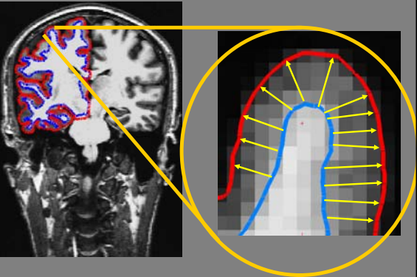
Cortical Thickness

Slide 48
?h.aparc.stats files for cortical surface measures
Aggregate stats for multiple subjects
StructName NumVert SurfArea GrayVol ThickAvg ThickStd MeanCurv GausCurv FoldInd CurvInd
unknown 10863 7151 13207 1.776 1.629 0.121 0.107 383 50.8
bankssts 1222 830 2290 2.711 0.559 0.112 0.027 10 1.3
caudalanteriorcingulate 830 585 1459 2.474 0.569 0.128 0.020 10 0.7
caudalmiddlefrontal 2509 1658 4979 2.653 0.567 0.125 0.035 27 3.5
corpuscallosum 2124 1340 569 0.489 0.631 0.151 0.110 87 8.0
cuneus 2737 1706 3086 1.741 0.509 0.162 0.065 52 8.0
entorhinal 495 330 1685 3.150 0.753 0.149 0.187 15 1.5
fusiform 3878 2638 7887 2.627 0.724 0.137 0.046 57 6.7
$: aparcstats2table --subjects bert ernie fred --hemi rh
--meas thickness --tablefile aparc_stats.txt

Slide 49
Beyond atlas-based ROI estimates
Qdec = Query, Design, Estimate, Contrast
GUI interface to perform inter-subject/group averaging on the cortical surface
GLM based models (mri_glmfit)
y = X * beta
y is a vector of observed data (e.g., thickness at each vertex)
X is the known design (e.g., age, gender)
beta is unknown parameter estimates
https://surfer.nmr.mgh.harvard.edu/fswiki/FsTutorial/QdecGroupAnalysis_freeview
https://surfer.nmr.mgh.harvard.edu/fswiki/FsTutorial/GlmReview

Slide 50
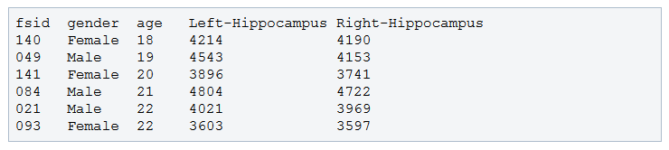
Qdec input files
qdec.table.dat

Slide 51
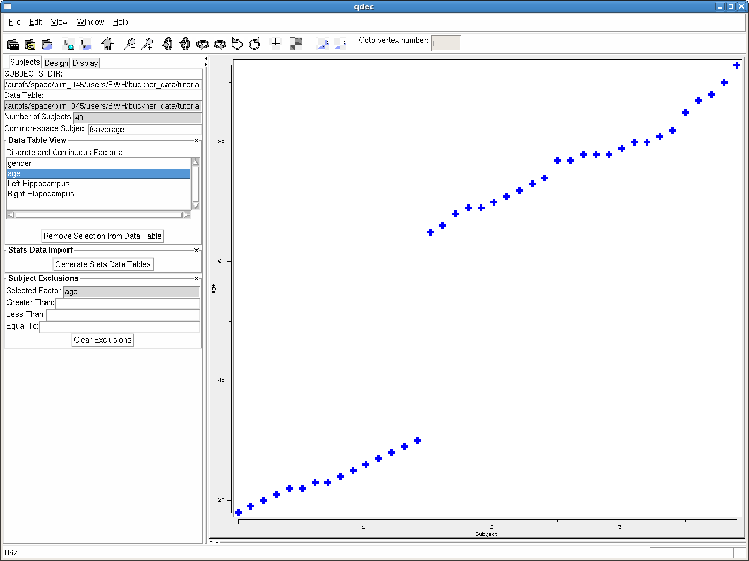
Reading in qdec.table.dat

Slide 52
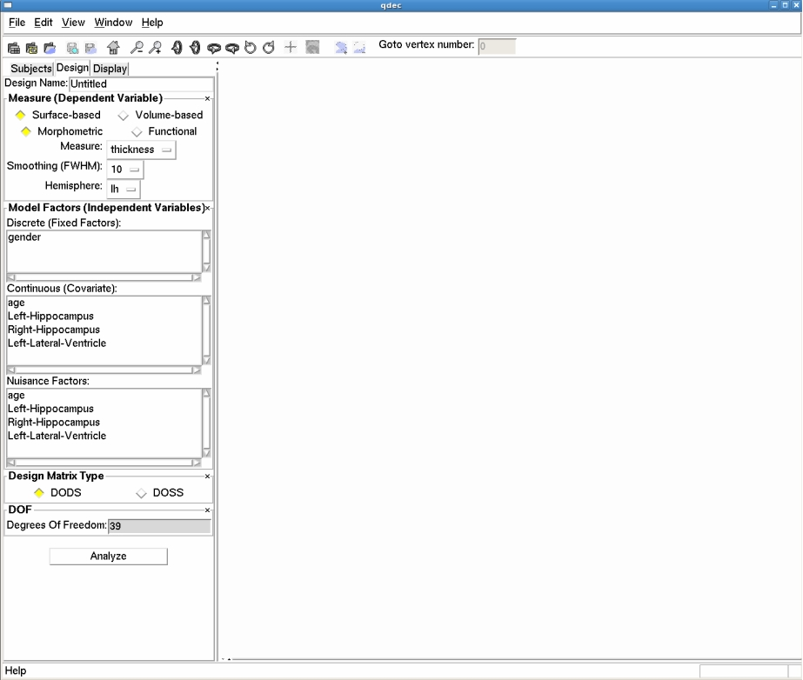
Specifying GLM design
Note. Up to 4 factors allowed in GUI interface. More complex models require command line usage of mri_glmfit
https://surfer.nmr.mgh.harvard.edu/fswiki/FsTutorial/GroupAnalysis

Slide 53
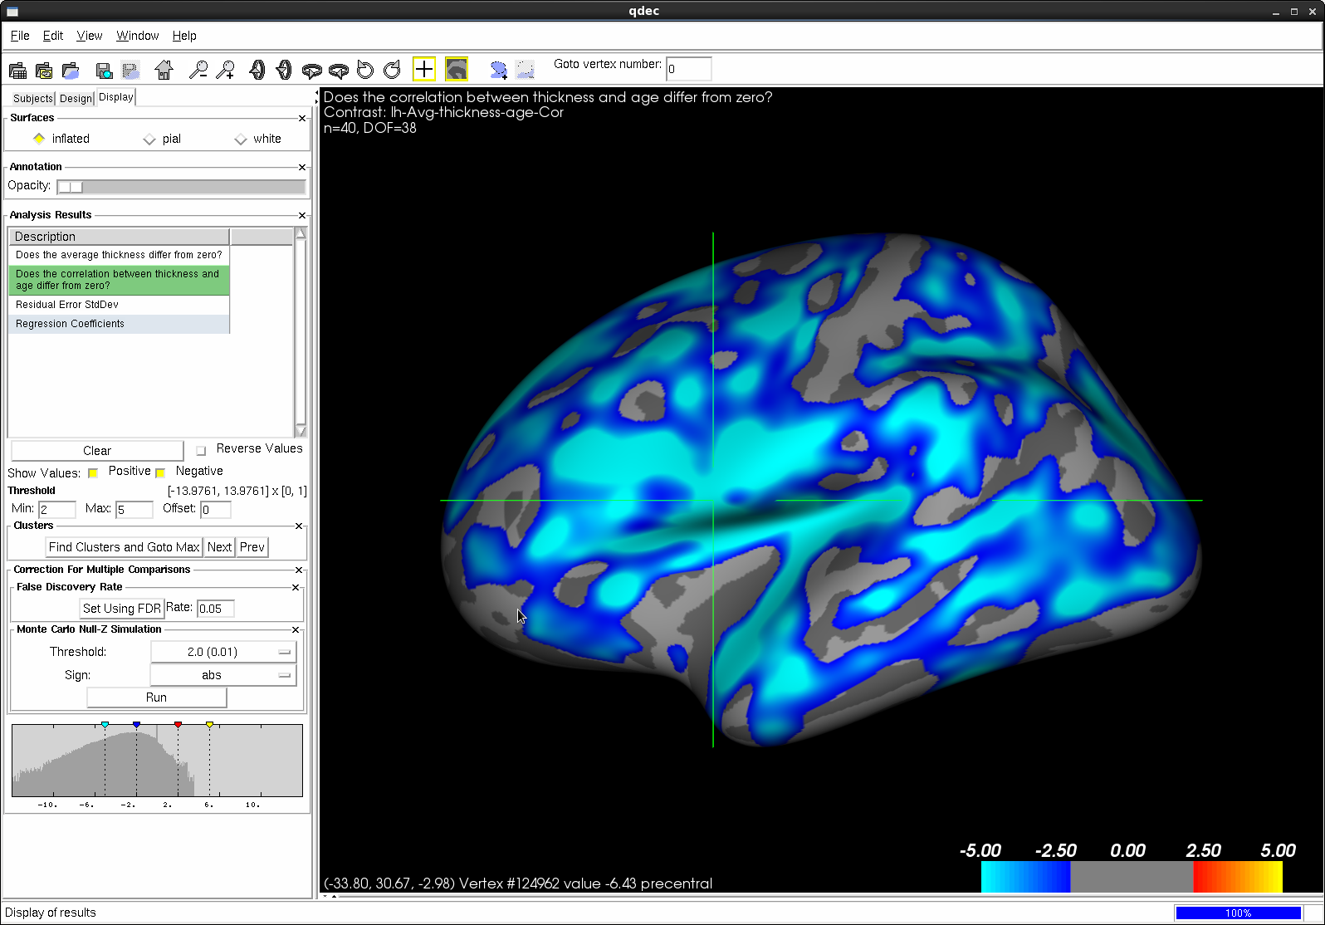
Displaying results

Slide 54
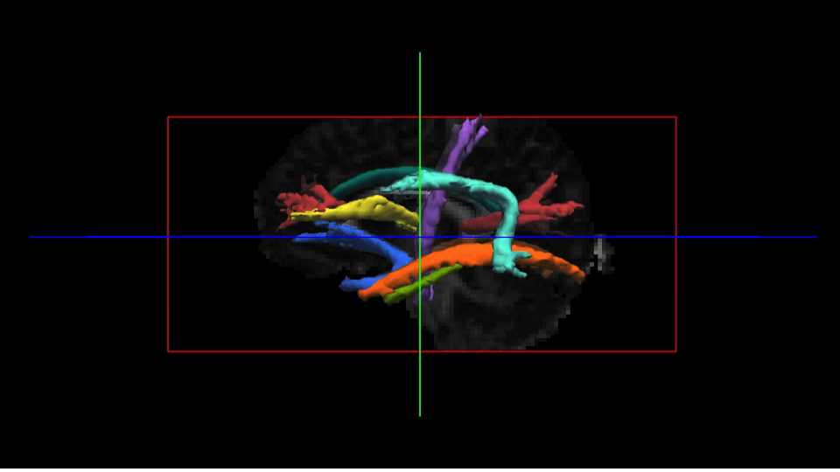
Diffusion MRI + FreeSurfer
TRACULA = TRActs Constrained by UnderLying Anatomy
Global probabilistic tractography with priors on anatomical neighbors
Requires segmentation from the structural stream (apar+aseg.mgz)

Slide 55
What can TRACULA do?
Global tractography
Models entire path between two regions
Best for reconstruction of known wm pathways
But TRACULA is not for:
Exploratory tractography
e.g., you provide a seed

Slide 56
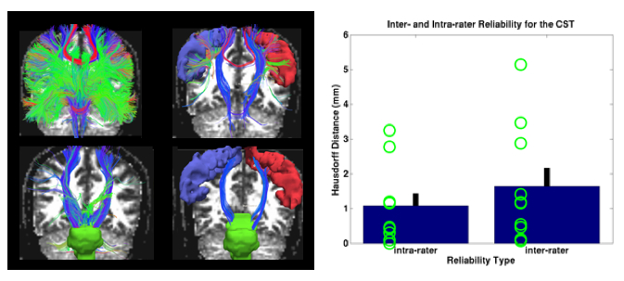
White matter Pathway Atlas
Corticospinal tract
Inferior longitudinal fasciculus
Uncinate fasciculus
Corpus callosum
Forceps major
Forceps minor
Anterior thalamic radiation
Cingulum
Cingulate (supracallosal)
Angular (infracallosal)
Superior longitudinal fasciculus
Parietal
Temporal
Automated probabilistic reconstruction of white-matter pathways in health and disease using an atlas of the underlying anatomy. Yendiki A., et al., (2011). Front. Neuroinform. 5:23. doi: 10.3389/fninf.2011.00023

Slide 57
TRACULA input
Simplest configuration file (all default options)
setenv SUBJECTS_DIR /path/to/fs/output/directory
set subjlist = (bert ernie oscar …)
set dcmlist = (/path/to/bert/1.dcm /path/to/ernie/011-1.dcm …)
set bveclist = (/path/to/bvecs-bert.txt /path/to/bvecs-ernie.txt …)
set bvallist = (/path/to/bvals-bert.txt /path/to/bvals-ernie.txt …)
See the example configuration file for all possible inputs
https://surfer.nmr.mgh.harvard.edu/fswiki/dmrirc

Slide 58
TRACULA usage
Step 1 – preprocessing (distortion compensation, registration)
$: trac-all –prep –c bert_config.txt
Step 2 – Fitting of ball-and-stick model (FSL’s bedpostx)
$: trac-all –bedp –c bert_config.txt
Step 3 – Reconstruct pathways
$: trac-all –path –c bert_config.txt

Slide 59
trac-all -prep
Includes the following steps:
Image corrections: -corr
Quality assessment (e.g., motion): -qa
Intra-subject registration (DWI to T1) : -intra
Inter-subject registration (T1 to template) : -inter
Anatomical masks and labels : -mask
Tensor fit : -tensor
Anatomical priors : -prior

Slide 60
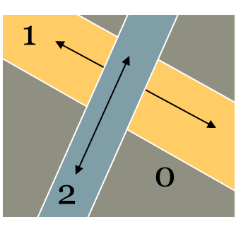
trac-all -bedp
Inferfaces with FSL to run bedpostX to fit ball-and-stick model of diffusion to every voxel
Takes a while to run
Run on grid server to take advantage of parallel processing!

Slide 61

trac-all -path
Reconstruct the 18 paths using random sampling algorithm

Slide 62


TRACULA Output
Probability distribution of each pathway
Tract-based diffusion measures
FA, MD, RD, AD
pathstats.overall.txt : Averaged over entire pathway
Pathstats.by.voxel.txt : as a function of position along the pathway

Slide 63
And so much more
Structural Analyses
Specialized longitudinal pipelines
Functional MRI
Statistical analysis of functional data on the cortical surface (FS-FAST)
PET Imaging
PETSurfer for ROI-based, surface based, and whole-brain analysis of PET data
Multimodal registration
Within and across subjects

Slide 64
More References
Martinos Center for Biomedical Engineering: http://nmr.mgh.harvard.edu
FreeSurfer Wiki: http://FreeSurfer.net/fswiki
FreeSurfer Mailing List: http://surfer.nmr.mgh.harvard.edu/fswiki/FreeSurferSupport
FreeSurfer Youtube Channel: https://www.youtube.com/channel/UCruQerP8aa-gYttXkAcyveA
CNL Freesurfer Guide for using Freeview and surface analysis tips: http://vitallongevity.utdallas.edu/cnl/wp-content/uploads/2015/10/FREESURFER_GUIDE_CNL_2015Oct.pdf

